Slide 1

ENGLISH PREMIERE LEAGUE MATCH RESULTS How to build a betting strategy
ROLEX TEAM
Alexandre Lang, Joël Kuflom, Abdul Aloraib Alsalim & Alix Muller
Notes:
Hi everyone!
So today, with the Rolex Team, we will show you how to build a betting strategy !
To fulfil this goal, we will use a dataset containing English Premiere League Match Results. This dataset gave us variables about the match statistics such as the referee, the number of shots etc, but also Odds from different betting websites. What is an odd? I’ll show you

Slide 2
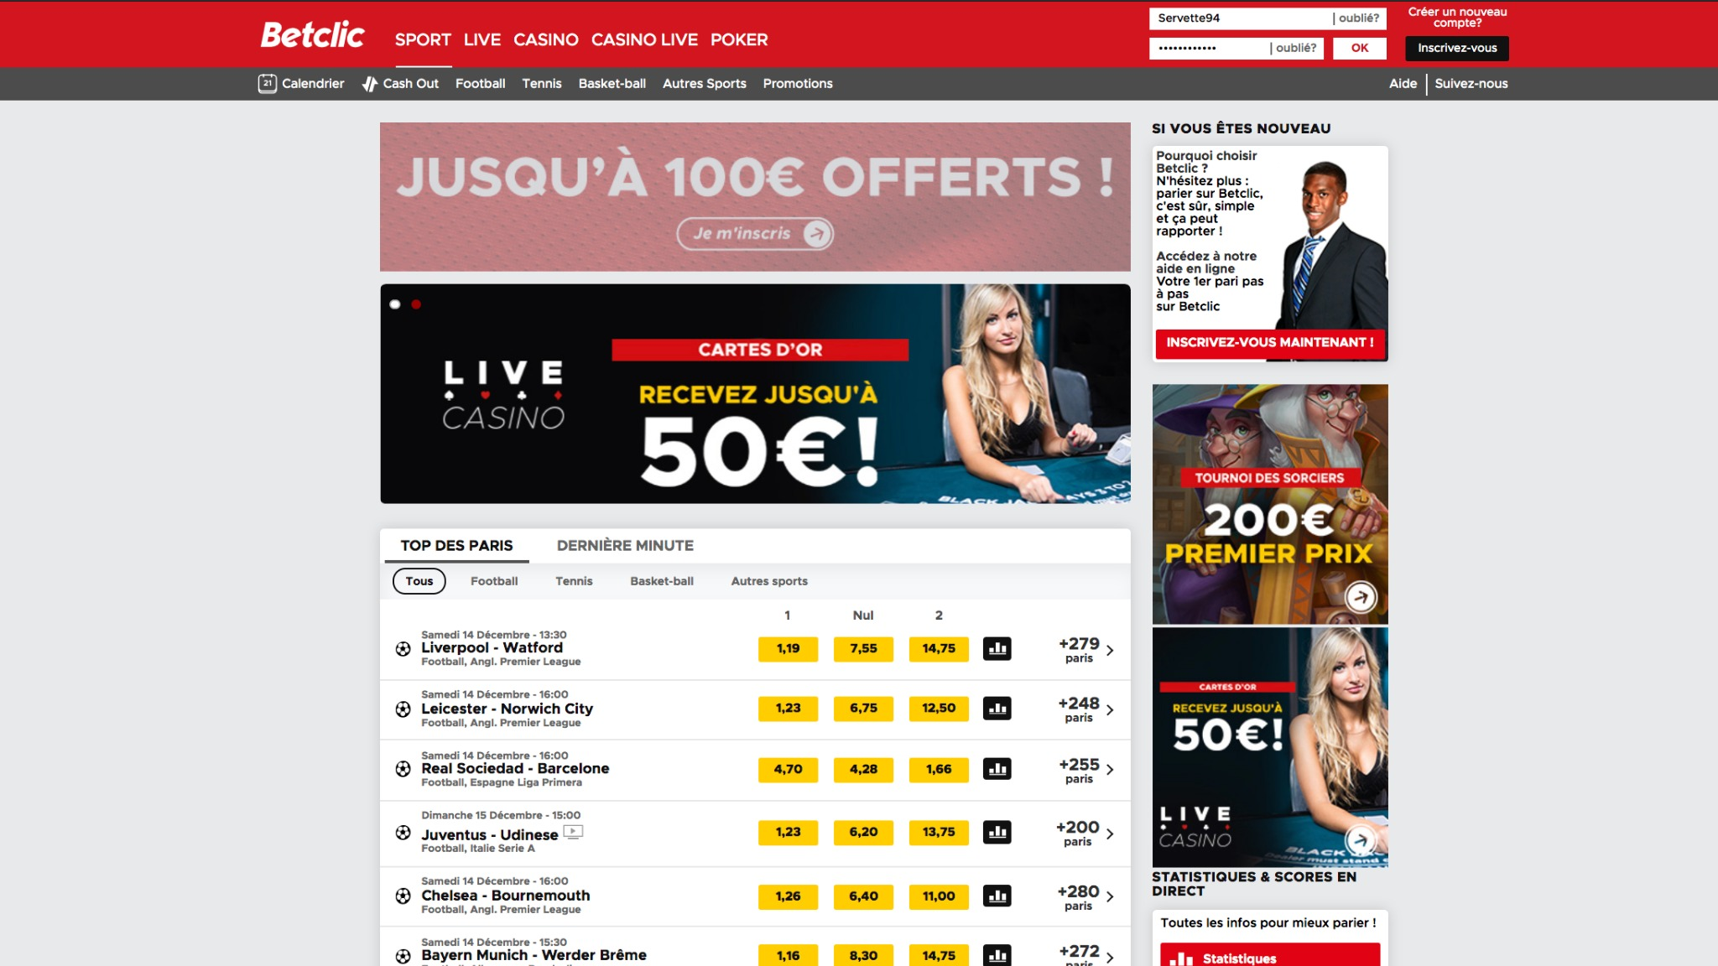
Notes:
So imagine you would like to bet on a football game. You would go on this kind of website, this one called Betclic.

Slide 3
Notes:
You can see here the next football game, with the home and away teams.

Slide 4
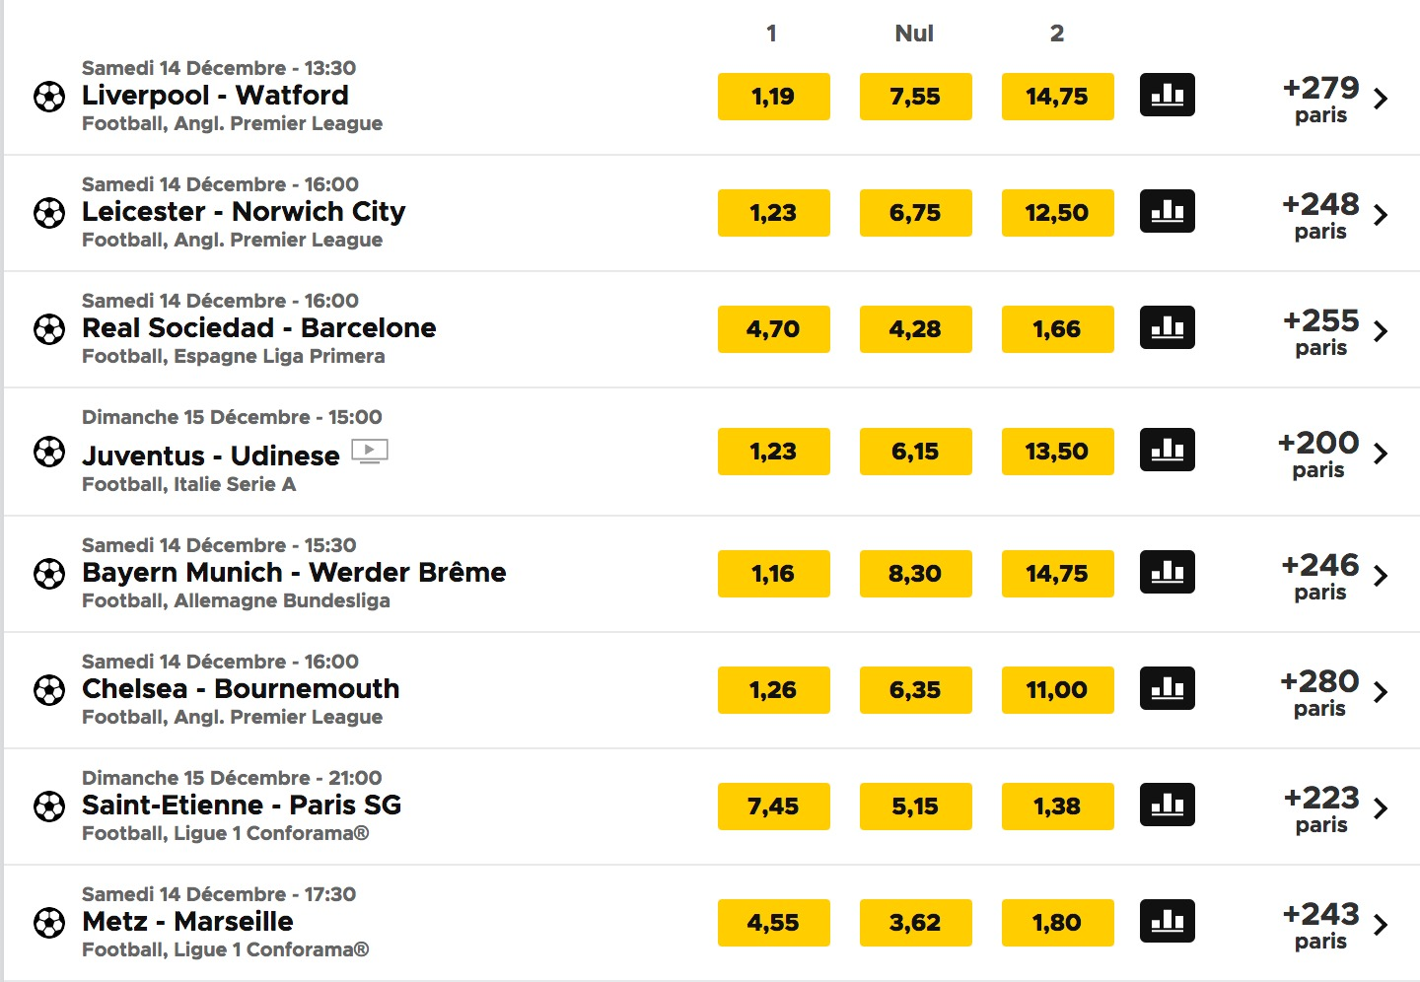
3 Odds
You can bet on one of these 3 results
Notes:
The yellow numbers there are the previous called Odds!
The role of the odd number is to multiply your initial bet, but only in the scenario where your prediction realised itself !

Slide 5
Odd if
Liverpool wins
Notes:
For example this is the odd that will multiply your bet if Liverpool wins

Slide 6
Odd if
the match result is Draw
Notes:
For example this is the odd that will multiply your bet if the match results as Draw

Slide 7
Odd if
Watford wins
Notes:
For example this is the odd that will multiply your bet if the team Watford wins.
So if you bet 100 francs on Watford, and that Watford really wins => you will earn 1’475 !

Slide 8
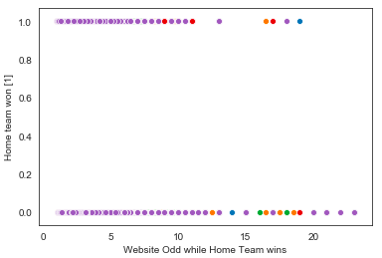
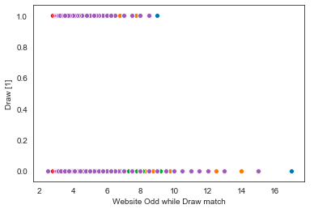
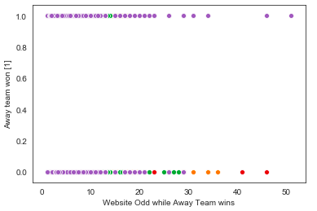
SCATTER PLOTS → Odds distribution Trends
Draw Match
HOME WIN or NOT WIN
ODD NUMBER for HOME
Home Team WIN
Away Team WIN
Odd for Home win crossed with : 1 = Home WON 0 = Home did not WIN
Odd for Draw Match crossed with : 1 = Draw 0 = No Draw
Odd for Away win crossed with : 1 = Away WON 0 = Away did not WIN
Notes:
So you understood, there is 3 possible match results:
The Home team win, a Draw match or the Away team win.
But this output is also a binary variable. For instance, the home team can WIN or NOT WIN.
Let look at these scatter plots.
The X axis is the odd number set by betting websites for the victory of HOME, going from 1 to 25
The Y axis is binary : 1=HOME WON while 0 = did NOT WIN
We can see that sometimes people have seen their initial bet multiplied by more than 15 times! So here, it is the Betting website that have lost money
When we look at Draw matches, not a lots of big winners, and for away team... Sometimes people have won 50 times their initial bets !

Slide 9
THE METHODOLOGY for Classification
Logistic Regression
Odds
Match Statistics
One for...
Decision Trees
EQUATIONS
MODELS
VARIABLES
Home WINS Draw Away WINS
Odds
Match Statistics
Notes:
So, here we face a Classification problem. To build the best betting strategy possible, we need to find the most accurate model calculating the match result.
In order to find it, we tried 2 different model: Logistric Regression and Decision Trees. We will also test two set of independent variables: does the odds predict better or the match statistics?

Slide 10
THE BEST MODEL
Logistic Regression
Odds
Match Statistics
Decision Trees
EQUATIONS
MODELS
VARIABLES
X
Home WINS
X

Slide 11

BEST MODEL RESULTS W LOGISTIC REGRESSION WITH MATCH STATISTICS
Default rate
Accuracy
Precision
46%
69%
a
71%
Of Home teams
actually won
Of the predictions
were correct
Of True Positives over Actual Positives
When we say the Home team will win...
71%
really wins!

Slide 12

CONCLUSION W THE FINAL RESULTS OF THIS ANALYSIS
Complex to predict match results, however:
Better to use Match statistics over Odds → EMOTIONAL STIMULATION (NUMBERS)
Better to use Logistic Regression over Decision trees → MORE ACCURATE WHEN GOOD DISTRIBUTION
... with improvements and more variables,
this model could be used to build a prediction website!

Slide 13
THANK YOU

Slide 14
FINAL RESULTS, model accuracy
 | HOME WIN Odds, Match Statistics | DRAW Odds, Match Statistics | AWAY WIN Odds, Match Statistics
LOGISTIC REGRESSION | 60%, 69% | 74%, 74% | 70%, 76%
DECISION TREE | 59%, 66% | 74%, 74% | 72%, 74%

Slide 15
FINAL RESULTS, Precision / Recall
 | HOME WIN Odds, Match Statistics | DRAW Odds, Match Statistics | AWAY WIN Odds, Match Statistics
LOGISTIC REGRESSION | Pre: 62% / 71% Rec: 60% / 66% | Pre: 0% / NaN Rec: 0% / 0% | Pre: 0% / 68% Rec: 0% / 42%
DECISION TREE | 11% / 11% 4% / 4% | 21% / 21% 15% / 15% | 68% / 68% 42% / 42%

Slide 16
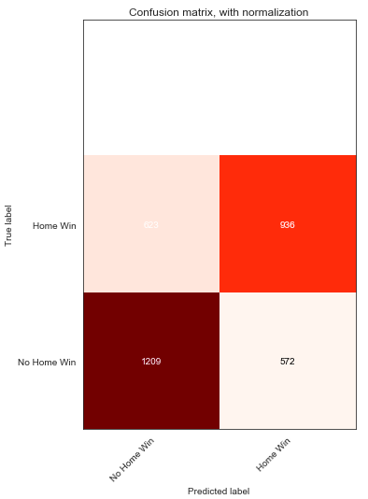
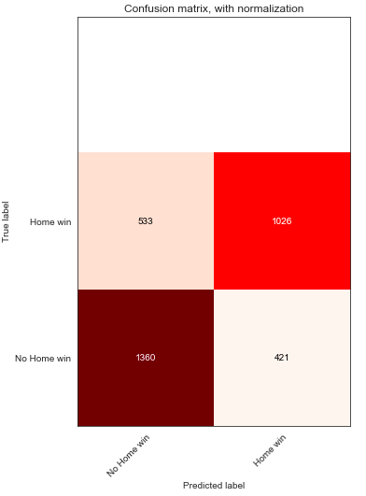
Logistic Regression
Odds
Statistics

Slide 17
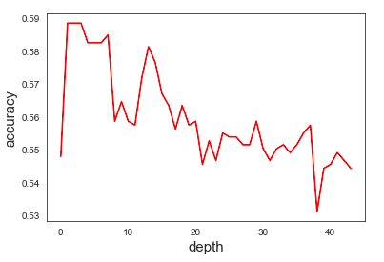
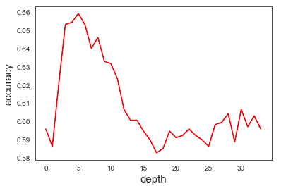
Decision Trees
Odds
Statistics

